Slide 1
Survey Results:
Treatment from Adults on GHS Campus
Prepared by Sherri Koski
April 2021
=

Slide 2
Introduction
A survey was given to the students of Glenn High School. The students were asked how do they feel they are treated by adults on campus. The students rated how they felt they are treated from 1-4 with 4 being the highest.
The student were asked to explain their rating and/or provide examples. Students were not required to enter a comment.
This survey question was answered by 851 students. The students were asked their grade, race, virtual or in-person, SES status and if they were SPED or on a 504.

Slide 3
Objective
The objective of this project is to look specifically at the comments given by the students. These are the questions that I will seek to answer.
Who writes the longest and shortest comments?
Does race or grade make a difference in the word choices students use to describe how they are treated?
Note: I cannot determine whether or not the word was used in a positive vs negative way. I can only count how often the word is used.

Slide 4

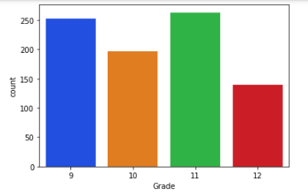
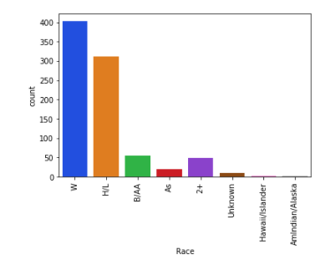
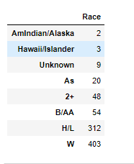
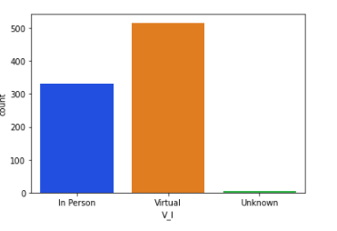
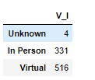
Who we surveyed
I made a choice to remove American Indian/Alaska Native, Hawaiian/Pacific Islander and Unknown from the data. This represents 1.65% of the total respondents

Slide 5
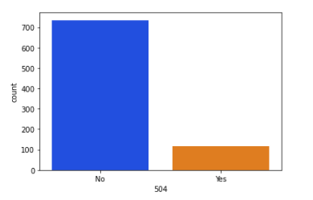
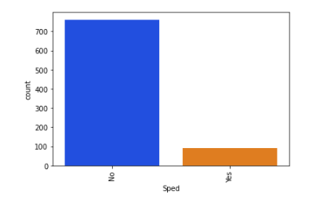
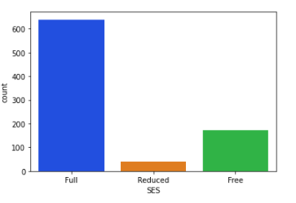

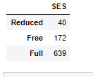

More about who we surveyed

Slide 6
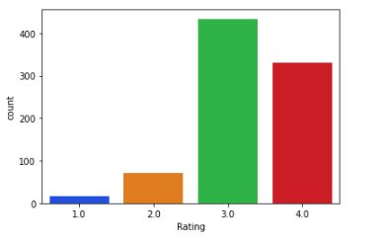
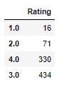
The ratings overall.
Students overwhelmingly feel well treated at Glenn.

Slide 7
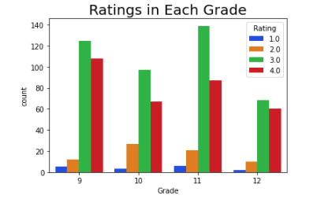
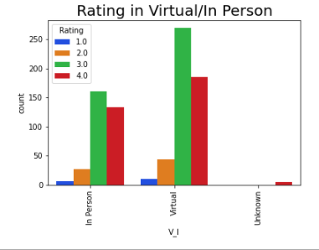
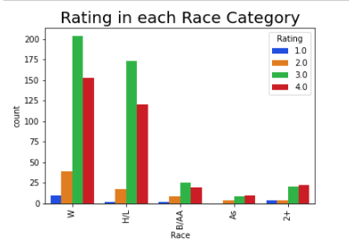
Ratings in Grade, Race, and Virtual/In Person are very similar. The only thing that stands out is the Asian Race did not rank any 1's.
20/851 students selected Asian.

Slide 8
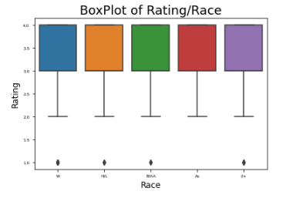
This is virtually the same. It's nice to see that the rating of 1 is considered and 'outlier'.
This is one of the reasons why I did not focus on ratings. The boxplots on all categories were identical and statistically not interesting.
However, the lack of differences should be noted as well.

Slide 9
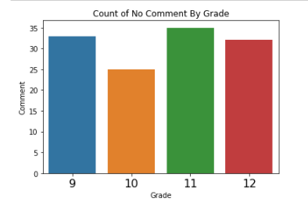
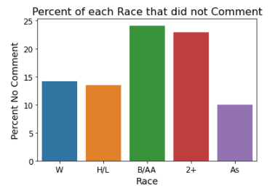
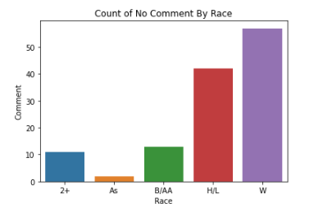
Word Count
The mean word count for the population of the survey is 10.565 words per comment. No comment counted as 0 words.
There were 125 no comments
Why did 24% of Black/AA students not comment? Why did 23% of 2+ not comment?
There are 54 Black/AA students. 13/54
There are 48 2+ students. 11/48

Slide 10
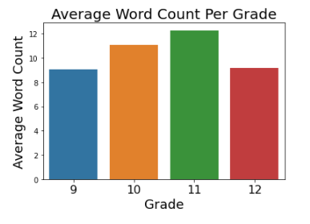
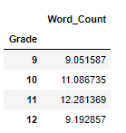
Average Word Count for each Grade Level
The average word count is 10.565.

Slide 11
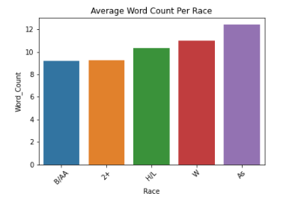
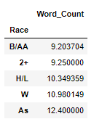
Average Word Count for each Race specified
The average word count is 10.565.
B/AA and 2+ had 24% and 23% as no comment. I gave no comment a 0 for word count.
B/AA and 2+ were about 1.25 words below the average of 10.565 words.

Slide 12
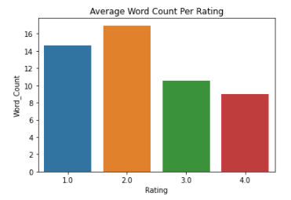
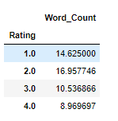
Average Word Count for each Rating
The average word count is 10.565.

Slide 13
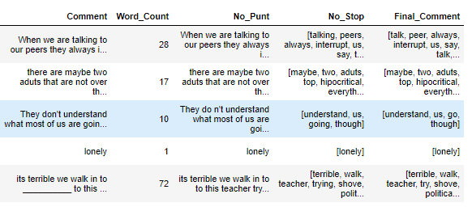
Word Choices:
Comments were cleaned up by eliminating punctuation, eliminating little words like and, the, or and then the words were simplified by making words such playing into play.

Slide 14
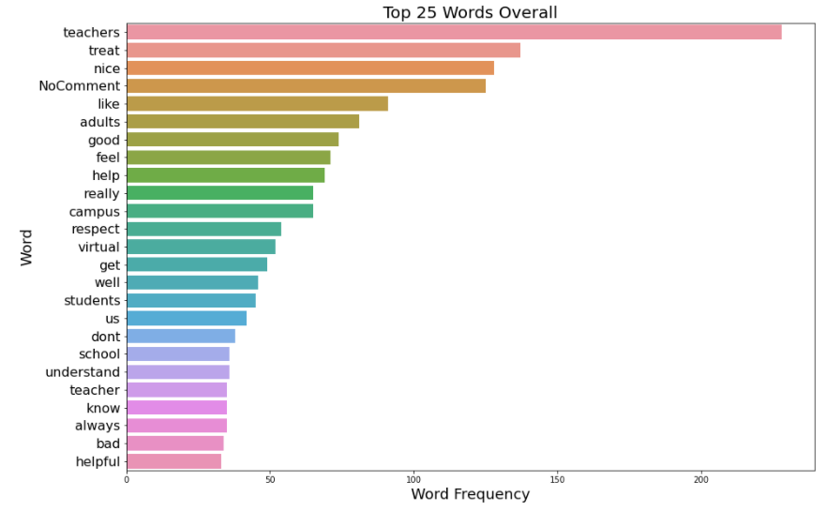
Top 25 Words Written --All Glenn students
Teachers
treat
nice

Slide 15
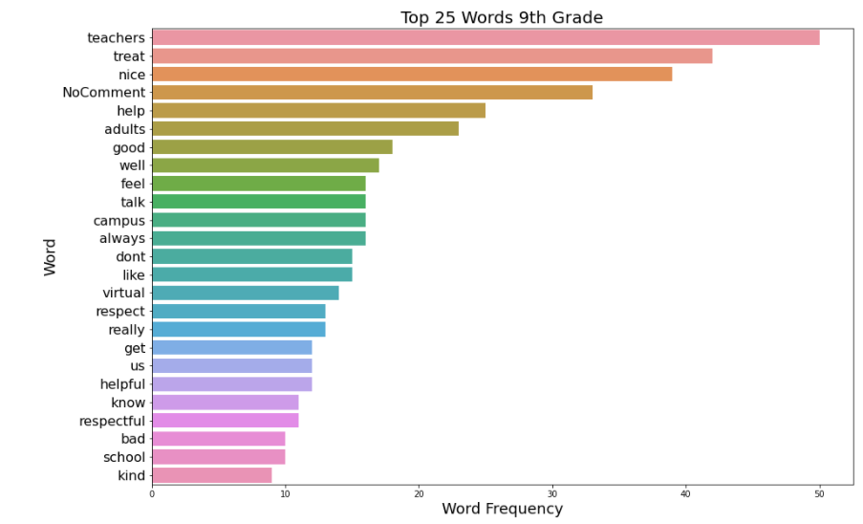
Top 25 Words Written --9th Grade
Teachers
treat
nice
This is campus and Freshman so far

Slide 16
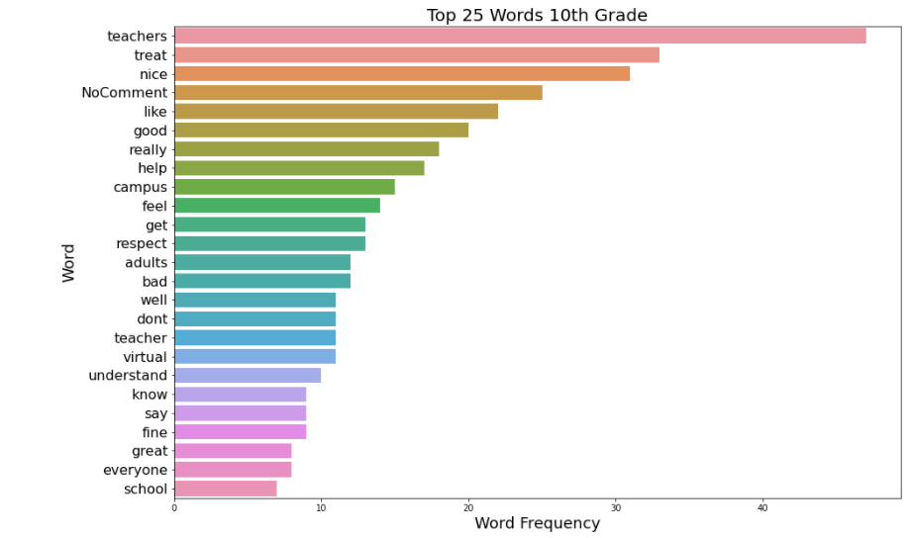
Top 25 Words Written --10th Grade
Teachers
treat
nice

Slide 17
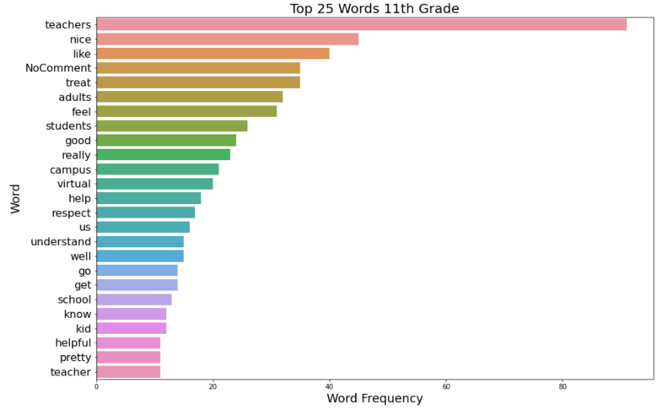
Top 25 Words Written --11th Grade
Teachers
treat
nice

Slide 18
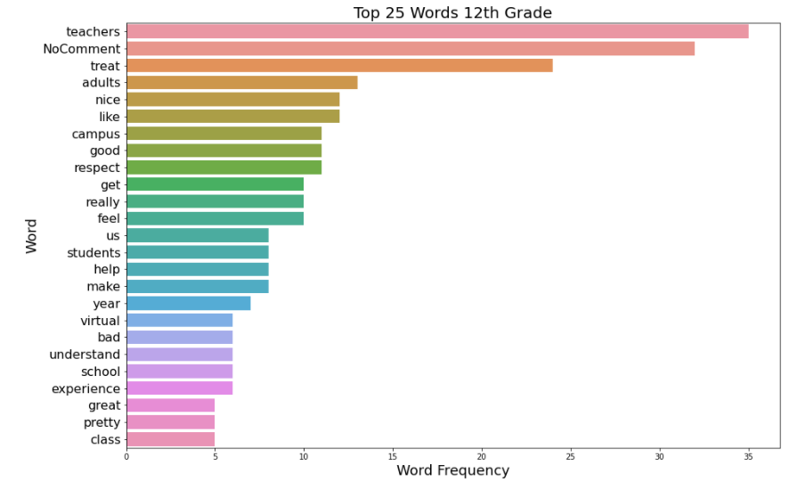
Top 25 Words Written --12th Grade
Teachers
treat
adults
nice

Slide 19
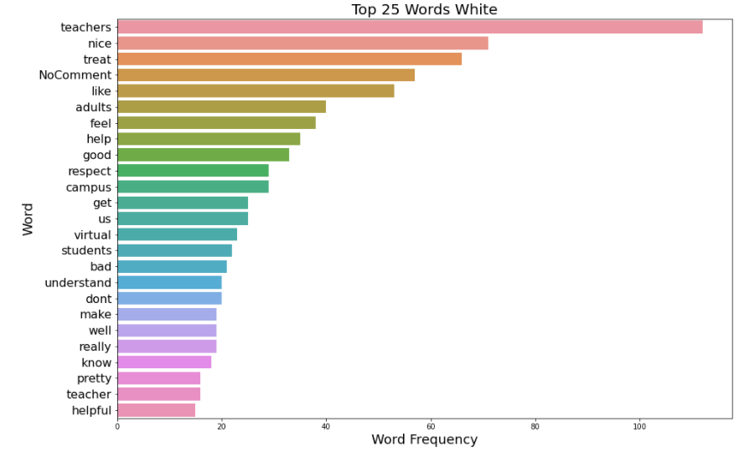
Top 25 Words Written --White
Teachers
nice
treat

Slide 20
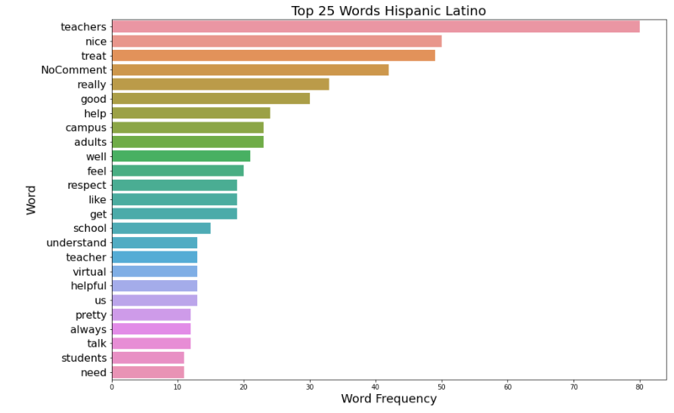
Top 25 Words Written --Hispanic Latino
Teachers
nice
treat

Slide 21
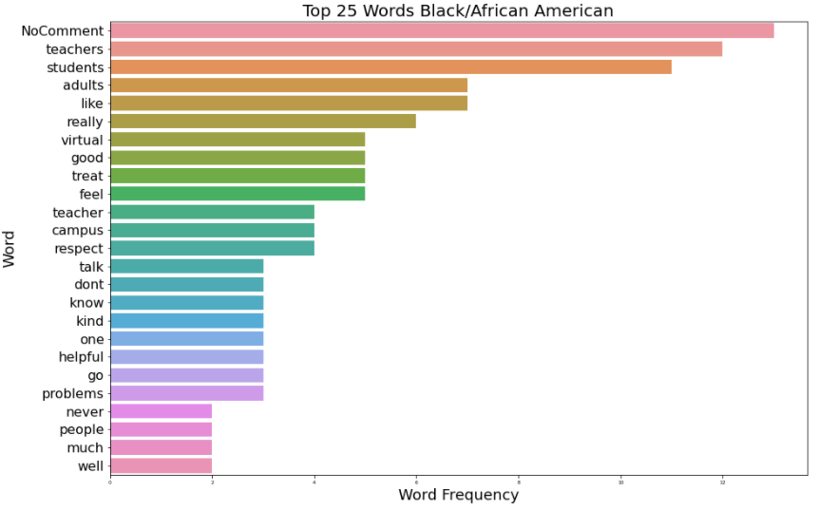
Top 25 Words Written --Black/African American
No Comment
Nice is not on this list.
25% of this smaller population did not comment.

Slide 22
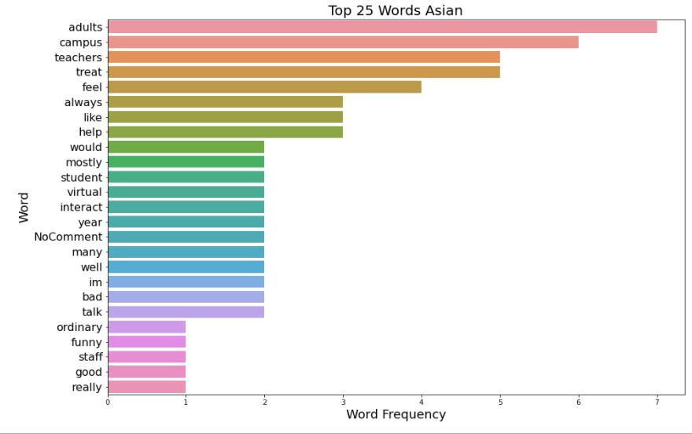
Top 25 Words Written --Asian
This population is 20 students.
Notice how far No Comment is down the list.
The question asked how they felt they were treated by adults. This population wrote more about adults rather than teachers.

Slide 23
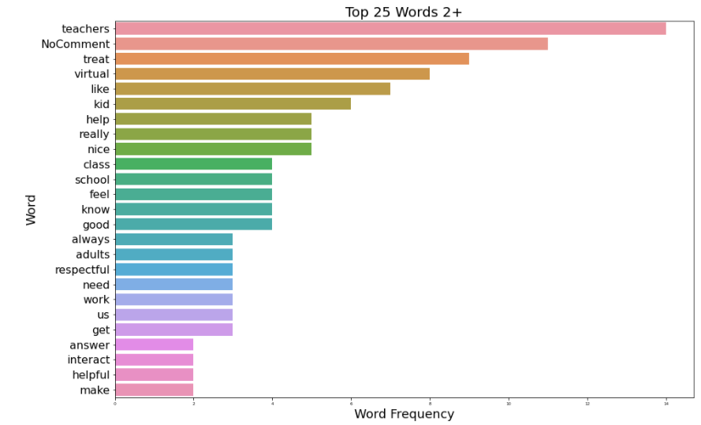
Top 25 Words Written --2+
teachers
treat
virtual
kid
24% did choose not to respond. This population is 48 students.

Slide 24
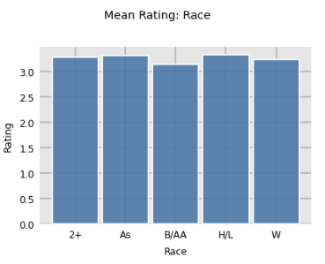
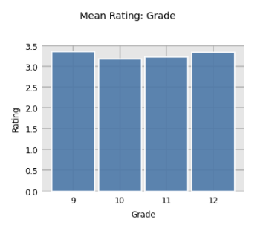
Little extra:
I decided at the last moment(ok to be honest, I found this new graphing library).
These are the graphs of the average satisfaction scores among different populations.
The mean is very close but slightly lower in B/AA. 2+, As, and H/L are all just above W.

Slide 25
Conclusion:
Overall, all students groups: Grade, Race, Sped, 504, SES, Virtual or In Person rank their treatment by the adults at Glenn High School favorably.
Questions:
Why did 24% of Black/African American students not write comments?
Why did 23% of the 2+ students not write comments?
Why do Asian students write more?
Maybe add a multiple choice question, if you did not comment, why?

Slide 26
What other questions do you have?

